Slide 1
Class work for Tues. March 8th
For the period today, you have three goals:
Read about and choose one of 3 encryption algorithms.
Write a class called Crypt which can encrypt and decrypt a file using your algorithm.
Test your code for speed and accuracy.
8-<number>

Slide 2
Goal 1: Choose an Algorithm
You have several resources attached to the assignment Lab: Crypt up on SchoolLoop.
First, find the file Crypt Ciphers.doc
Read up on the 3 possible ciphers.
They are generally in order of difficulty. Choose option 1 for an easier algorithm, or option 3 for a tougher one.
The document describes the algorithms, but you’ll also get examples of encrypted files in a moment.
7-<number>

Slide 3
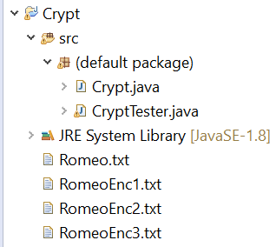
Goal 2: Code your Algorithm
Now, find the file CryptTester.zip
Add all of the files inside to a new project called Crypt. Your project should now look like this:
8-<number>

Slide 4
Code your Algorithm
Your goal is to complete the Crypt class. To do this, you’ll be writing an encrypt and decrypt method for your chosen algorithm.
Each of these methods should:
  Read from the file passed in as parameter
  Modify the alphabetic text following the algorithm
  Write the output to the file name passed as parameter
For more info, you can also check out the slides attached to Lab: Crypt.
7-<number>

Slide 5
Code your Algorithm
FAQ:
  What do we do with spaces/punctuation?
    All of these algorithms only apply to letters. Leave all other types of characters unchanged when encrypting. Retain capitalization as well (uppercase stays uppercase, lower case stays lowercase)
  Why are there 4 Romeo files?
    There is an original (used for testing), and one version of the file encrypted using each of the 3 algorithms. Check out these files to see what your output should look like! Don’t overwrite them, though (the tester uses these to tell if your code is working).
  What the heck do all of the “Style Requirements” listed on the lab slides even mean? And the contest?
    Don’t worry about those too much for now. For today, focus on the Structural Requirements and getting your code working.
7-<number>

Slide 6
Goal 3: Test your Code
Once you have at least an encrypt method, you can try running my tester!
Speed is always a concern, but for now, worry more about functionality.
You will know your encrypt method works if the tester says
Does the encrypted file match the sample? true
You will know your decrypt method works if the tester also says
Is the file the same after an encrypt, then a decrypt? true
8-<number>

Slide 7
Test your Code
At the end of the period today, turn in whatever you have so far to Lab: Crypt (not for grading, just for me to check out).
On Thursday, we’ll work on getting this code running faster. You’ll be ready for it as long as your code works.
If you’re not done yet, try to get working code by Thursday so that you’re ready for the next piece.
7-<number>

